Slide 1
Exam Review Mix

Slide 2
In the SR, wages and prices are often

Slide 3
Slope of the LRAS curve?

Slide 4
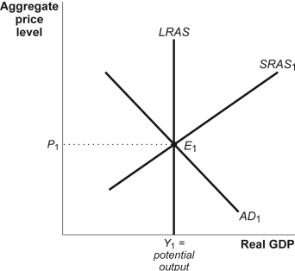
Describe

Slide 5
Describe again

Slide 6
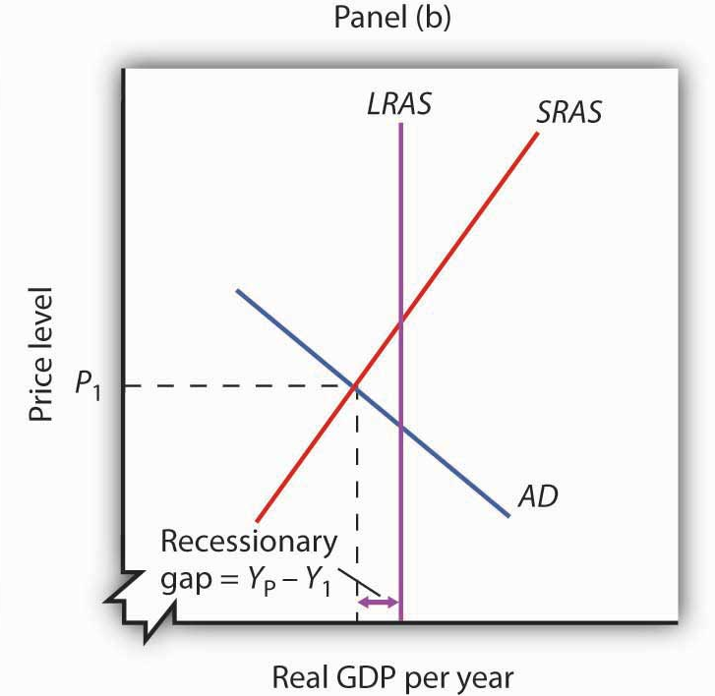
Describe

Slide 7
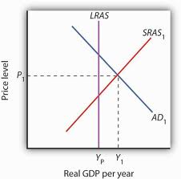
Describe

Slide 8
Government Stimulus Checks

Slide 9
A short streak of beautiful weather that improves employee morale

Slide 10
European recession

Slide 11
20 million immigrants in one year

Slide 12
Which types of unemployment exist?

Slide 13
Demand-side economic policies become ineffective in which range of the SRAS curve?

Slide 14
PPC

Slide 15
AD/AS LR equilibrium

Slide 16
Money Market Graph

Slide 17
Loanable Funds Graph

Slide 18
Phillips Curve

Slide 19
Foreign Exchange dollar and euro

Slide 20
Demand for Money and Functions of Money
Transaction Demand
Asset Demand
Store of Value
Medium of Exchange

Slide 21
Demand for Money and Functions of Money
Transaction Demand
Asset Demand
Store of Value
Medium of Exchange
Which function is missing?

Slide 22
Appreciate or Depreciate?
Increase interest rates

Slide 23
Appreciate or Depreciate?
Relatively high inflation

Slide 24
Appreciate or Depreciate?
Increase exports

Slide 25
Appreciate or Depreciate?
Contractionary monetary policy

Slide 26
Appreciate or Depreciate?
Government deficit spending

Slide 27
Better indicator of increased standard of living
Real per capita GDP
Nominal per capita GDP

Slide 28
How can unemployment go down without new job creation?

Slide 29
Opportunity cost of holding cash

Slide 30
Shows an inverse relationship between inflation rate and unemployment

Slide 31
3 Fed Tools

Slide 32
Vertical range of SRAS

Slide 33
Unemployment at vertical range of SRAS

Slide 34
Monetary/Fiscal combo that will most def lead to increased inflation

Slide 35
$ depreciates. NX?

Slide 36
Measures change in prices of a fixed basket of goods

Slide 37
Increased spending of $10 million
MPC of .9
Max GDP change?

