Slide 1
Sides Game

Slide 2
Revenue EXCEEDS EXPENDITURE

Slide 3
Current Debt
16 trillion
17 trillion
18 trillion
19 trillion

Slide 4
Sum of All Deficits and Surpluses

Slide 5
Supply-side
Funny nickname

Slide 6
Spending that Requires Annual Congressional Approval

Slide 7
Revenue EQUALS Expenditure

Slide 8
Largest Mandatory Spending

Slide 9
Expenditure EXCEEDS Revenue

Slide 10
Largest Discretionary Spending

Slide 11
2016 Deficit
5.9 billion
59 billion
590 billion
5.9 trillion

Slide 12
2016 Revenue
1.4 trillion
2.7 trillion
3.3 trillion
6.2 trillion

Slide 13
2016 Expenditure
1.4 trillion
2.7 trillion
3.9 trillion
6.2 trillion

Slide 14
Aggregate Means

Slide 15
Largest Source of Revenue

Slide 16
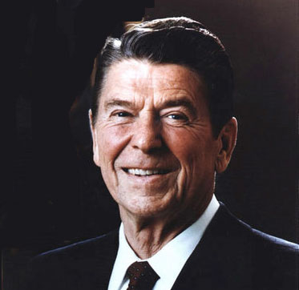
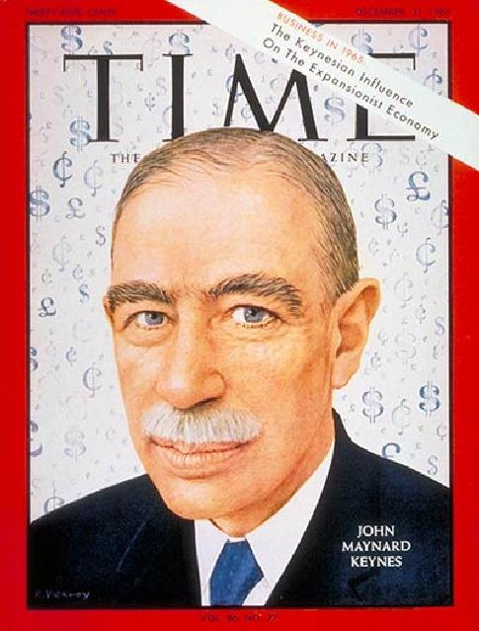
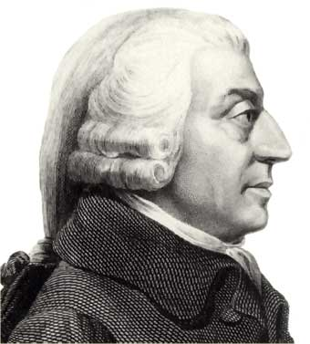
Supply-side

Slide 17
Example of Excise Tax

Slide 18
Example of Payroll Tax

Slide 19
Adam Smith Book

Slide 20
Demand-side

Slide 21
PL stands for

Slide 22
Output Measurement

Slide 23
Laissez-Faire

Slide 24
Keynes supported _____-side

Slide 25
Reagan supported _____-side

Slide 26
Invisible Hand

Slide 27
Monetary Policy

Slide 28
Anything generally accepted as payment

Slide 29
When prices increase and the value of each dollar decreases

Slide 30
Current Fed chairman

Slide 31
# of Fed Reserve Banks

Slide 33
Interest Rate the Fed charges banks

Slide 34
Buying and Selling of Bonds by the Fed is called…

Slide 35
During an inflationary period the Fed will _______ the money supply

Slide 36
The Fed attempts to maximize employment while limiting …

Slide 37
Fiscal or Monetary
Controlled by politicians

Slide 38
Fiscal or Monetary
Government expediture

Slide 39
Fiscal or Monetary
Bond Buying

Slide 40
Fiscal or Monetary
Tax Policy

Slide 41
Fiscal or Monetary
The Fed

Slide 42
Fiscal or Monetary
Congress and the President

Slide 43
During a recession the Fed should
_____ the reserve requirement
_____ the discount rate
_____ bonds

