Slide 1
Sides Game

Slide 2
Revenue EXCEEDS EXPENDITURE
surplus

Slide 3
Current Debt
16 trillion
17 trillion
18 trillion
19 trillion

Slide 4
Sum of All Deficits and Surpluses
National debt

Slide 5
Supply-side
Funny nickname
Trickle down

Slide 6
Spending that Requires Annual Congressional Approval
discretionary

Slide 7
Revenue EQUALS Expenditure
Balanced budget

Slide 8
Largest Mandatory Spending
Social security

Slide 9
Expenditure EXCEEDS Revenue
Deficit

Slide 10
Largest Discretionary Spending
National defense

Slide 11
2016 Deficit
5.9 billion
59 billion
590 billion
5.9 trillion

Slide 12
2016 Revenue
1.4 trillion
2.7 trillion
3.3 trillion
6.2 trillion

Slide 13
2016 Expenditure
1.4 trillion
2.7 trillion
3.9 trillion
6.2 trillion

Slide 14
Aggregate Means
total

Slide 15
Largest Source of Revenue
Personal income tax

Slide 16
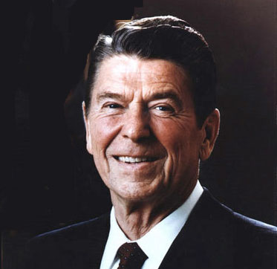
Supply-side

Slide 17
Example of Excise Tax
Cigarette and gas

Slide 18
Example of Payroll Tax
Social security and medicare

Slide 19
Adam Smith Book
Wealth of Nations

Slide 20
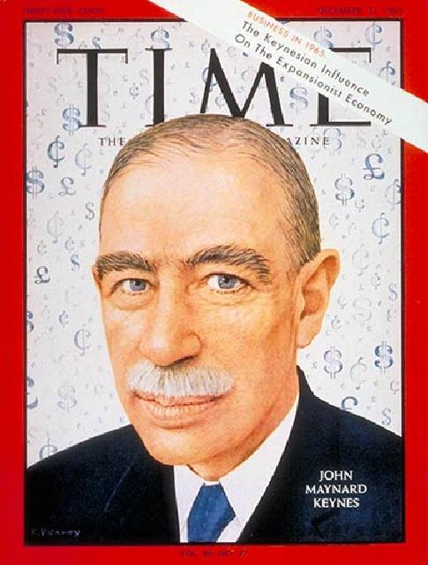
Demand-side

Slide 21
PL stands for
Price level

Slide 22
Output Measurement
GDP

Slide 23
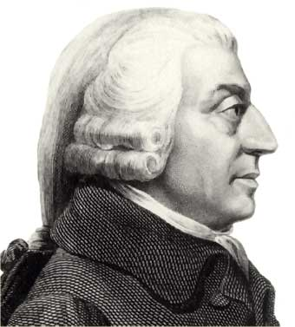
Laissez-Faire

Slide 24
Keynes supported demand-side

Slide 25
Reagan supported supply-side

Slide 26
Invisible Hand

Slide 27
Monetary Policy

Slide 28
Anything generally accepted as payment
money

Slide 29
When prices increase and the value of each dollar decreases
inflation

Slide 30
Current Fed chairman
JANET YELLEN

Slide 31
# of Fed Reserve Banks
12

Slide 32
Interest Rate the Fed charges banks
DISCOUNT RATE

Slide 33
Buying and Selling of Bonds by the Fed is called…
Open market operations

Slide 34
During an inflationary period the Fed will decrease the money supply

Slide 35
The Fed attempts to maximize employment while limiting …
inflation

Slide 36
Fiscal or Monetary
Controlled by politicians

Slide 37
Fiscal or Monetary
Government expenditure

Slide 38
Fiscal or Monetary
Bond Buying

Slide 39
Fiscal or Monetary
Tax Policy

Slide 40
Fiscal or Monetary
The Fed

Slide 41
Fiscal or Monetary
Congress and the President

Slide 42
During a recession the Fed should
decrease the reserve requirement
decrease the discount rate
buy bonds

